Slide 1
Smartphone Price Prediction Using Machine Learning
Machine Learning Project
by: Rohit Patil

Slide 2
🌍 Background & Business Context
• The Indian smartphone market is one of the fastest-growing consumer electronics markets.
• Prices vary across Amazon, Flipkart, Croma, Reliance Digital and Myntra.
• Machine learning helps estimate fair smartphone prices from hardware specifications.
❓ Problem Statement
• Develop a regression model to predict smartphone prices.
• Input features: Brand, RAM, Storage, Battery, Rating and Platform.
• Target variable: Listed Price (INR).
• Dataset size: 32,000 smartphone listings.

Slide 3
🎯 Project Objectives
• Build an accurate regression model.
• Analyze the impact of RAM, Storage and Battery.
• Compare Linear Regression, Random Forest, XGBoost and CatBoost.
• Evaluate using MAE, RMSE and R².
• Identify the most important features.
📊 Dataset Overview
Feature | Type
🛒 Platform | Categorical
🏷 Brand | Categorical
📱 Product Name | String
⭐ Rating | Float
💾 RAM | Categorical
💽 Storage | Categorical
🔋 Battery | Categorical
💰 Price | Target
📄 Total Records: 32,000
📊 Features: 10
🎯 Target: Price
💵 Range: ₹8,156–₹81,894

Slide 4
📊 Dataset Overview
Feature | Type
🛒 Platform | Categorical
🏷 Brand | Categorical
📱 Product Name | String
⭐ Rating | Float
💾 RAM | Categorical
💽 Storage | Categorical
🔋 Battery | Categorical
💰 Price | Target
📄 Total Records: 32,000
📊 Features: 10
🎯 Target: Price
💵 Range: ₹8,156–₹81,894

Slide 5
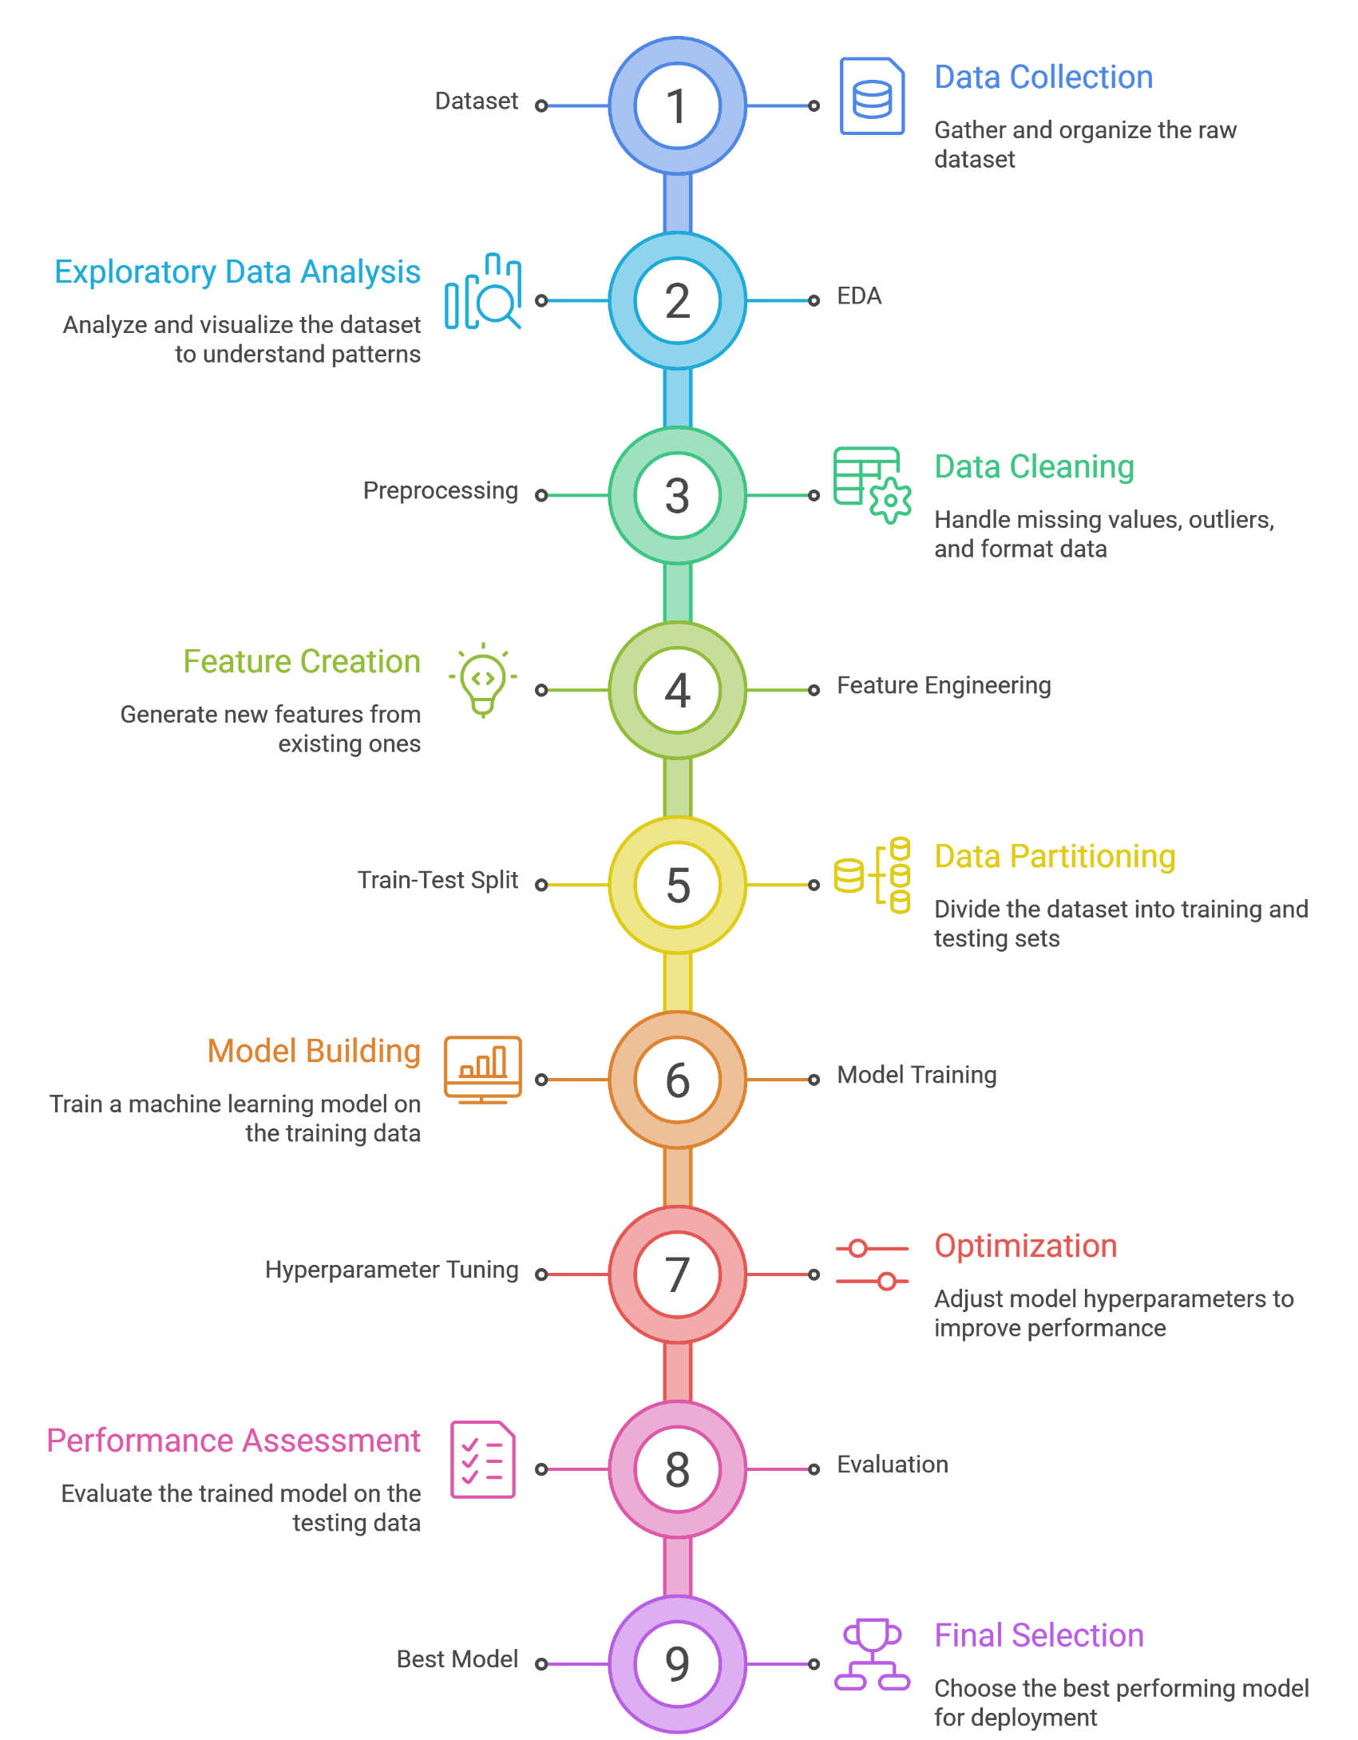
Methodology & Workflow -
EDA
Data Cleaning
Feature Engineering
Train-Test Split
Model Development
Hyperparameter Tuning
Evaluation

Slide 6
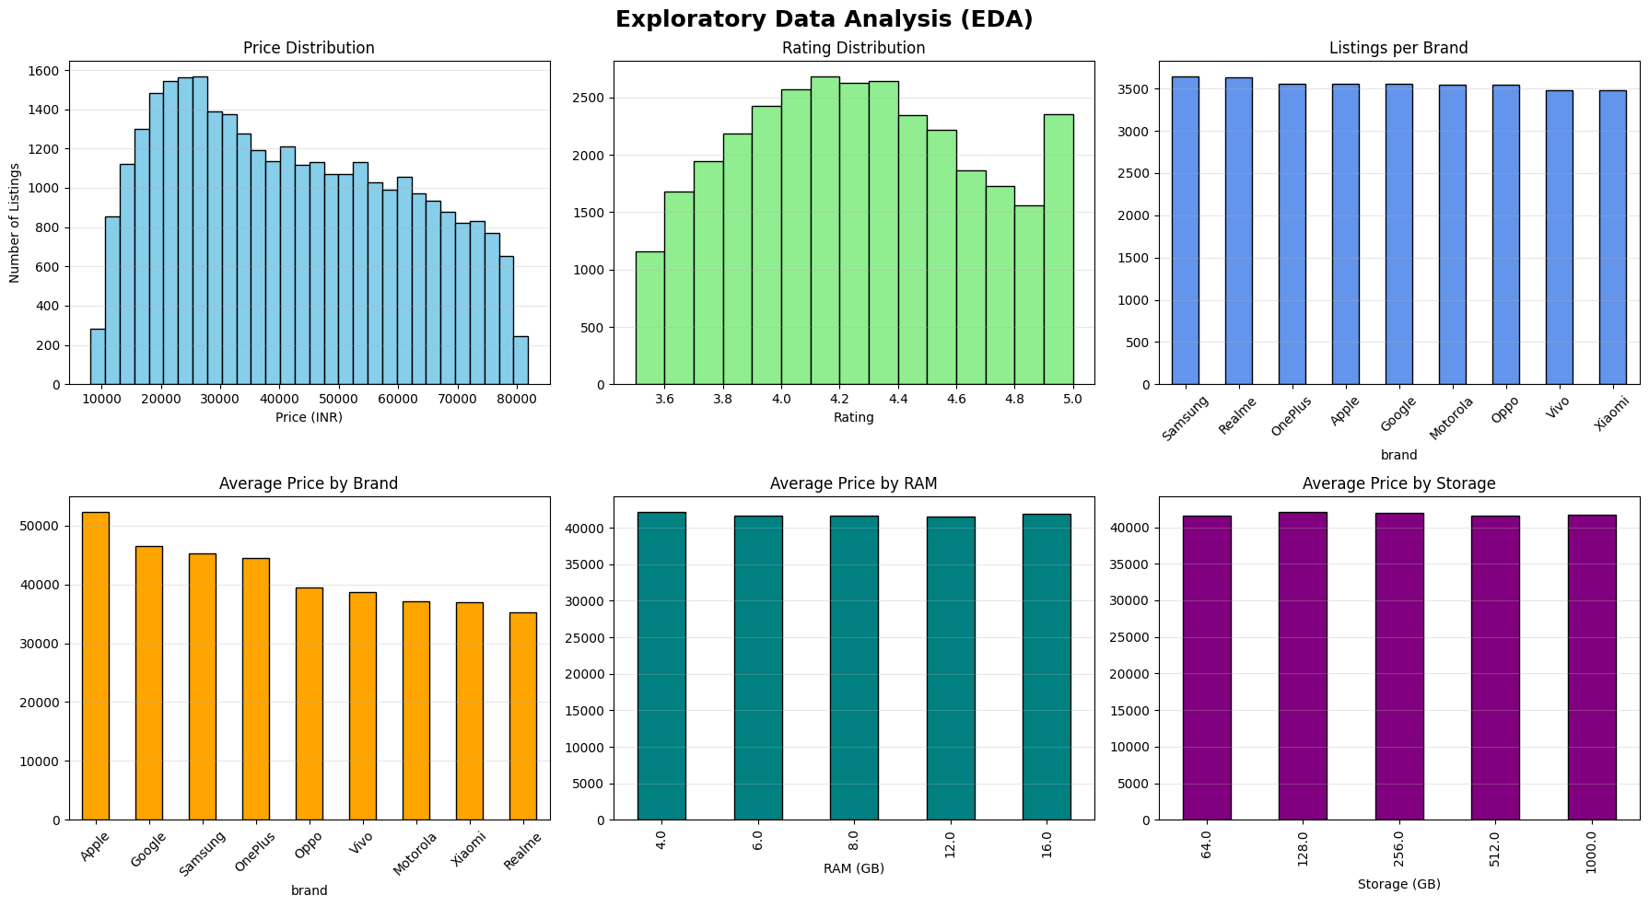
Exploratory Data Analysis

Slide 7
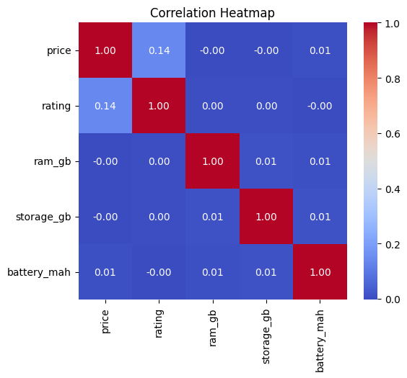
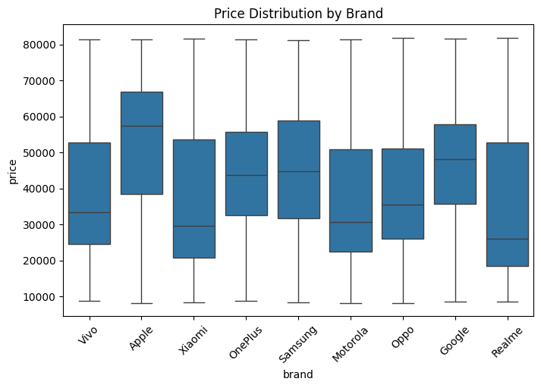
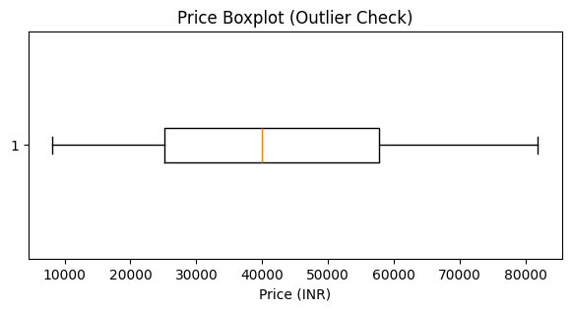
Exploratory Data Analysis on Original Data Set
Price Distribution
Brand-wise Price Analysis
Correlation Heatmap (Observed relationships between hardware and price)

Slide 8
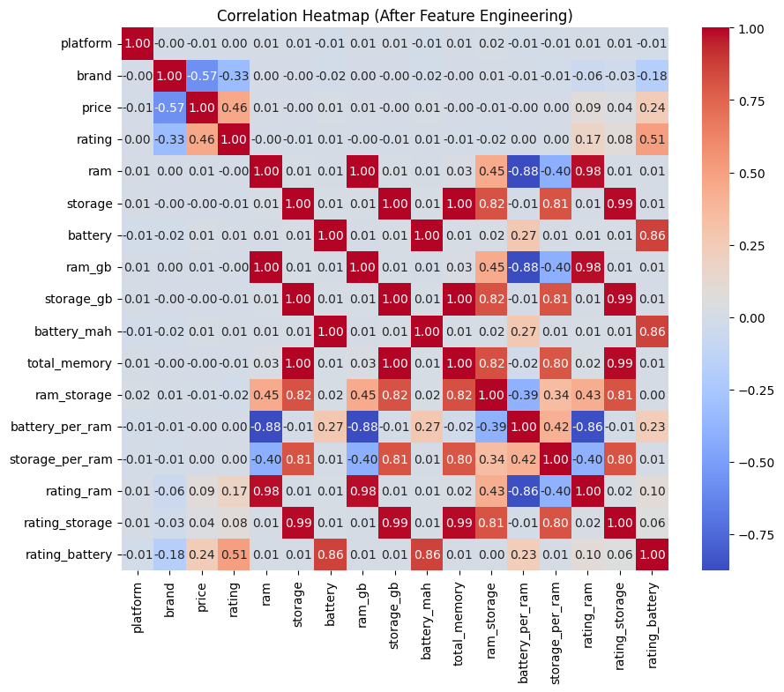
Feature Engineering on Synthetic Data Set-
Attribute | Value
Dataset Composition | 20,000 original + 12,000 synthetic records (provided with the dataset)
Data Usage | Synthetic data is selected during preprocessing

Slide 9
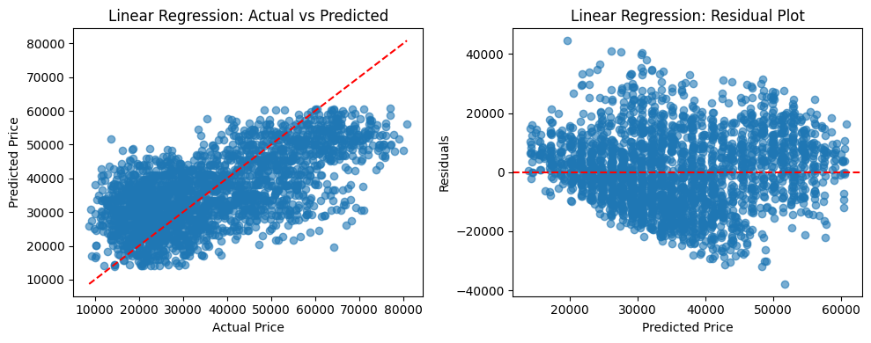
Linear Regression -
Linear Regression - MAE : 10097.452113510668 RMSE: 12472.829871244943 R2 : 0.4124635612367401

Slide 10
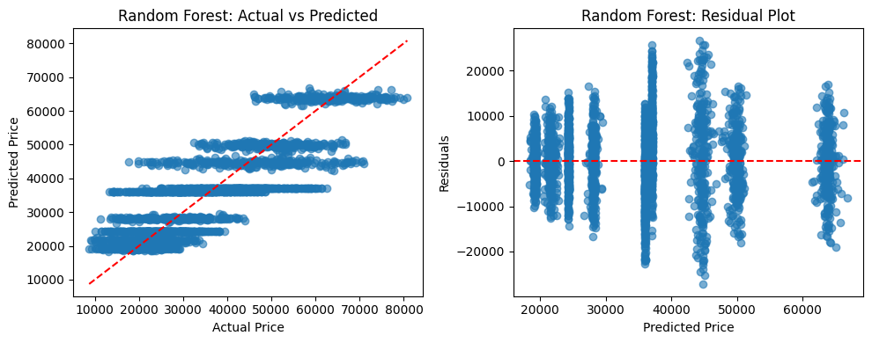
Random Forest Regression -
Random Forest - MAE : 6351.767194440064
RMSE: 8174.5114241762385
R2 : 0.7476354089787355

Slide 11
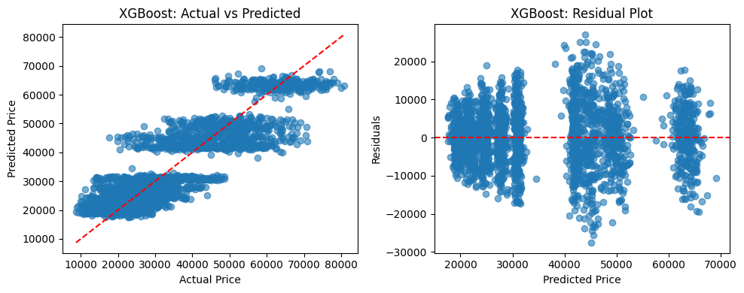
XGBoost Regression -
XGBoost MAE : 6107.2724609375 RMSE: 7792.19044941793 R2 : 0.7706895470619202

Slide 12
Model Comparison:
Model | MAE | RMSE | R² Score
XGBoost | 6,107.27 | 7,792.19 | 0.7707
Random Forest | 6,351.77 | 8,174.51 | 0.7476
Linear Regression | 10,097.45 | 12,472.83 | 0.4125

Slide 13
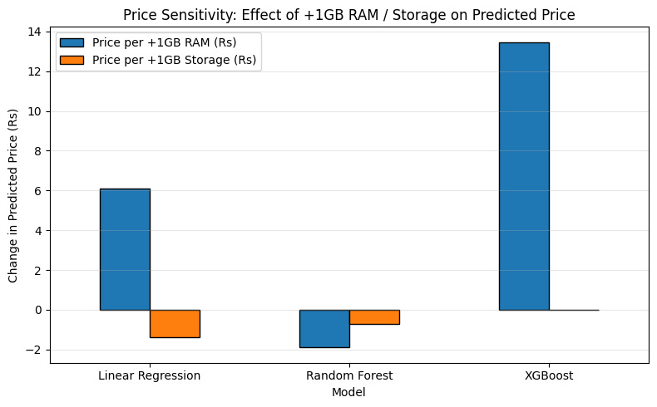
Price Sensitivity: Effect of
Model | Price per +1 GB RAM (₹) | Price per +1 GB Storage (₹)
Linear Regression | 6.11 | -1.37
Random Forest | -1.90 | -0.72
XGBoost | 13.46 | 0.00

Slide 14
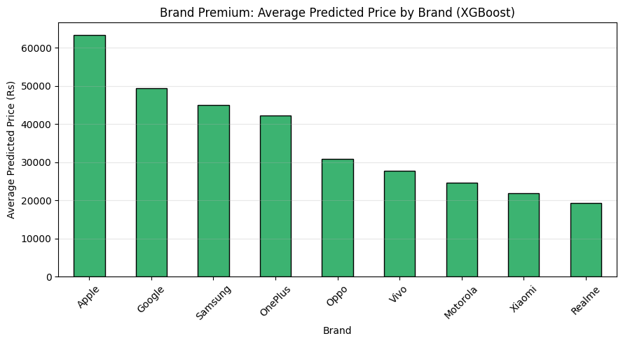
Brand Premium

Slide 15


